Slide 1
Fault Diagnosis & Tolerance Dr. M. Taskeen Raza
MS EE, Spring 2020
Week1

Slide 6
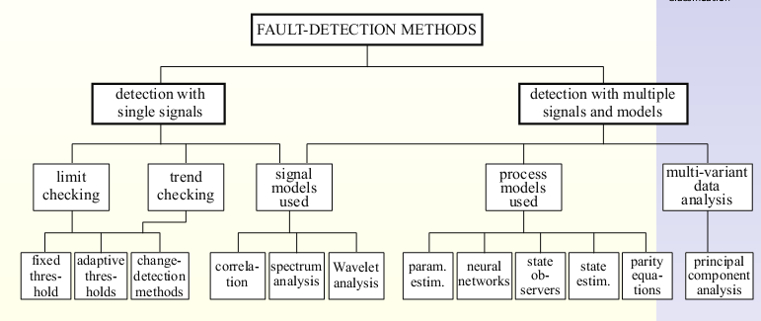

Slide 12
